Slide 1
Understanding Big Data

Slide 2
Topics Covered
Data
Data Storage and Analysis
What is big data?
why big data?
Big data technologies
Introduction to Hadoop.
open source technologies.
cloud and big data
mobile business intelligence
Crowd sourcing analytics
inter and trans firewall analytics.

Slide 3
Comparison with Other Systems,
Rational Database Management System ,
Grid Computing,
Volunteer Computing

Slide 4
Industry examples of big data
web analytics
big data and marketing
fraud and big data
risk and big data
credit risk management
big data and algorithmic trading
big data and healthcare
big data in medicine
advertising and big data

Slide 5
What is Data?
Data is a collection of facts, such as numbers, words, measurements, observations or even just descriptions of things.
Data – a collection of facts (numbers, words, measurements, observations, etc) that has been translated into a form that computers can process

Slide 6
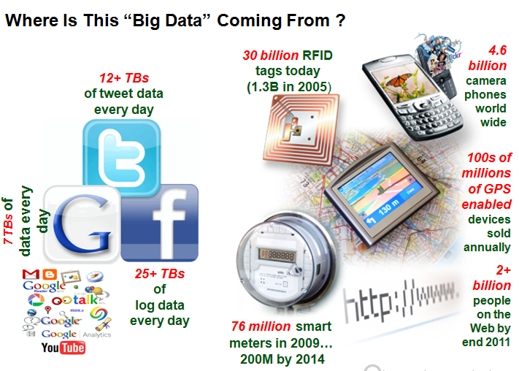

Slide 7
The New York Stock Exchange generates about one terabyte of new trade data per day
The Internet Archive stores around 2 petabytes of data, and is growing at a rate of 20 terabytes per month.
The Large Hadron Collider near Geneva, Switzerland, will produce about 15 petabytes of data per year.

Slide 8
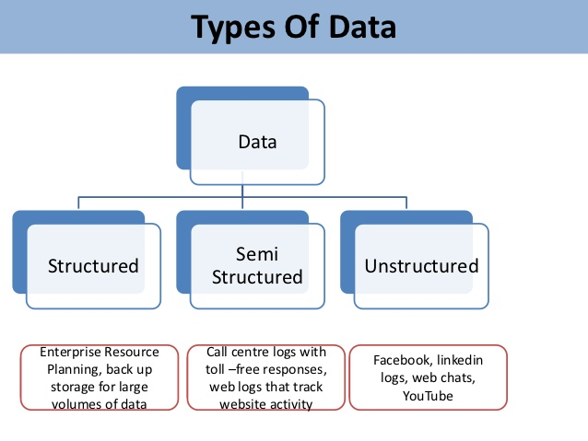
Types of data

Slide 9
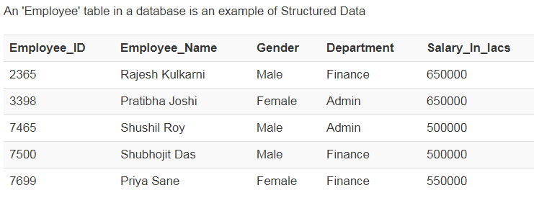
Structured Data
Any data that can be stored, accessed and processed in the form of fixed format.
Structured Data is used to refer to the data which is already stored in databases, in an ordered manner.

Slide 10
Unstructured data
Any data with unknown form is classified as unstructured data.
In addition to the size being huge, un-structured data poses multiple challenges in terms of its processing for deriving value out of it.
example of unstructured data is, a heterogeneous data source containing a combination of simple text files, images, videos etc.

Slide 11
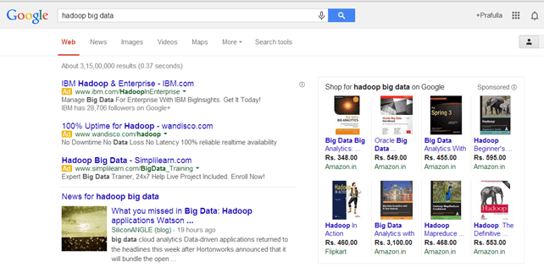
Examples Of Un-structured Data

Slide 12
Semi-structured data
Semi-structured data can contain both the forms of data.
We can see semi-structured data as a strcutured in form but it is actually not defined with e.g. a table definition in relational DBMS.
Example of semi-structured data is a data represented in XML file.

Slide 13
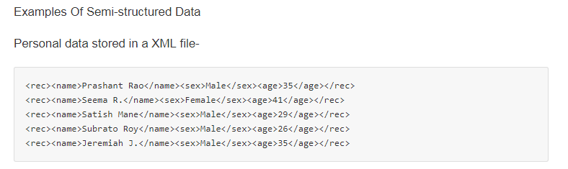

Slide 14
Data Storage and Analysis
How is data stored on a computer?
Data storage is a term for how information is kept in a digital format that may be retrieved at a later time.
Computers, laptops, tablets, smart phones and other devices all store data.
The methods and technologies used vary greatly, but the basic concept is always the same--information is kept so that it can be accessed again later.

Slide 15
Data Storage Technologies:
There are many different technologies used to store data:
Random Access Memory (RAM)
Hard Disk Drive
Flash Drive
SD (Secure Digital) Card
CDs/DVDs

Slide 16
the storage capacities of hard drives have increased massively over the years, access speeds.
The rate at which data can be read from drives— have not kept up. One typical drive from 1990 could store 1,370 MB of data and had a transfer speed of 4.4 MB/s
So, read all the data from a full drive in around five minutes

Slide 17
Over 20 years later, one terabyte drives are the norm, but the transfer speed is around 100 MB/s, so it takes more than two and a half hours to read all the data off the disk.
This is a long time to read all data on a single drive and writing is even slower.
The clear way to reduce the time is to read from multiple disks at once.
Imagine if we had 100 drives, each holding one hundredth of the data.
Working in parallel, we could read the data in under two minutes.

Slide 18
Only using one hundredth of a disk may seem wasteful.
But we can store one hundred datasets, each of which is one terabyte, and provide shared access to them.
We can imagine that the users of such a system would be happy to share access in return for shorter analysis times, and, statistically, that their analysis jobs would be likely to be spread over time, so they wouldn’t interfere with each other too much.

Slide 19
first problem to solve is hardware failure: as soon as you start using many pieces of hardware, the chance that one will fail is fairly high.
A common way of avoiding data loss is through replication: redundant copies of the data are kept by the system so that in the event of failure, there is another copy available.
This is how RAID works, for instance, although Hadoop’s filesystem, the Hadoop Distributed Filesystem (HDFS), takes a slightly different approach

Slide 20
What is Big Data?
Big data is a term that describes the large volume of data – both structured and unstructured – that overflow a business on a day-to-day basis.
But it’s not the amount of data that’s important.
It’s what organizations do with the data that matters.
Big data can be analyzed for insights that lead to better decisions and strategic business moves.

Slide 21
Big data is an evolving term that describes any huge amount of structured, semistructured and unstructured data that has the potential to be mined for information.

Slide 22
What is big data Analytics?
Big Data' is also a data but with a huge size.
'Big Data' is a term used to describe collection of data that is huge in size and yet growing exponentially with time.
In short, such a data is so large and complex that none of the traditional data management tools are able to store it or process it efficiently.

Slide 23
What Comes Under Big Data? (From where this data comes from)
Black Box Data : It is a component of helicopter, airplanes, and jets, etc. It captures voices of the flight crew, recordings of microphones and earphones, and the performance information of the aircraft.
Social Media Data : Social media such as Facebook and Twitter hold information and the views posted by millions of people across the globe.
Stock Exchange Data : The stock exchange data holds information about the ‘buy’ and ‘sell’ decisions made on a share of different companies made by the customers.

Slide 24
Power Grid Data : The power grid data holds information consumed by a particular node with respect to a base station.
Transport Data : Transport data includes model, capacity, distance and availability of a vehicle.
Search Engine Data : Search engines retrieve lots of data from different databases.

Slide 25
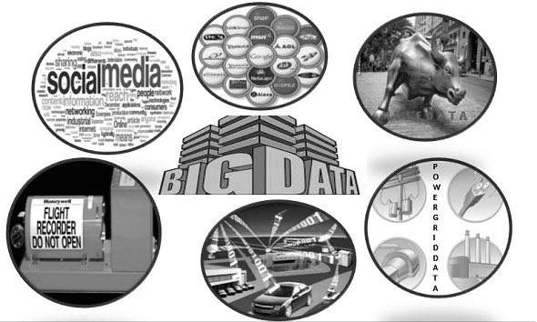

Slide 26
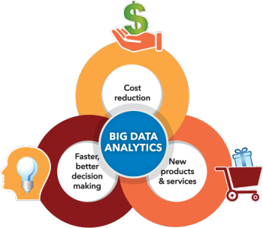
Why is big data analytics important?

Slide 27
Big data analytics helps organizations harness their data and use it to identify new opportunities.
Cost reduction. Big data technologies such as Hadoop and cloud-based analytics bring significant cost advantages when it comes to storing large amounts of data – plus they can identify more efficient ways of doing business.
Faster, better decision making. With the speed of Hadoop and in-memory analytics, combined with the ability to analyze new sources of data, businesses are able to analyze information immediately – and make decisions based on what they’ve learned.
New products and services. With the ability to gauge customer needs and satisfaction through analytics comes the power to give customers what they want. Davenport points out that with big data analytics, more companies are creating new products to meet customers’ needs.

Slide 28
Big Data analytics uses a wide variety of advanced analytics to provide
Deeper insights. Rather than looking at segments, classifications, regions, groups, or other summary levels you ’ll have insights into all the individuals, all the products, all the parts, all the events, all the transactions, etc.
Broader insights. The world is complex. Operating a business in a global, connected economy is very complex given constantly evolving and changing conditions. As humans, we simplify conditions so we can process events and understand what is happening. But our best-laid plans often go astray because of the estimating or approximating. Big Data analytics takes into account all the data, including new data sources, to understand the complex, evolving, and interrelated conditions to produce more accurate insights.
Frictionless actions. Increased reliability and accuracy that will allow the deeper and broader insights to be automated into systematic actions.

Slide 29
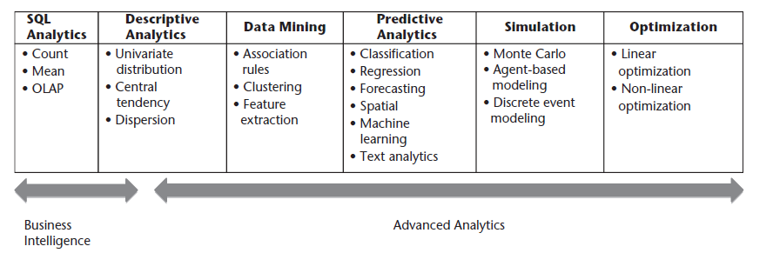
Advanced Big data analytics

Slide 30
Characteristics Of 'Big Data'
Volume. Organizations collect data from a variety of sources, including business transactions, social media and information from sensor or machine-to-machine data.
In the past, storing it would’ve been a problem – but new technologies (such as Hadoop) have eased the burden.

Slide 31
Velocity. Data streams in at an unprecedented speed and must be dealt with in a timely manner. RFID tags, sensors and smart metering are driving the need to deal with torrents of data in near-real time.
Variety. Data comes in all types of formats – from structured, numeric data in traditional databases to unstructured text documents, email, video, audio, stock tick

Slide 32
Why Big data?
Understanding and Targeting Customers:
big data is used to better understand customers and their behaviors and preferences.
Companies are keen to expand their traditional data sets with social media data, browser logs as well as text analytics and sensor data to get a more complete picture of their customers.

Slide 33
Understanding and Optimizing Business Processes:
Big data is also increasingly used to optimize business processes
Retailers are able to optimize their stock based on predictions generated from social media data, web search trends and weather forecasts.

Slide 34
Improving Healthcare and Public Health
Improving Sports Performance
Improving Science and Research

Slide 35
Big Data Technology
Technology is radically changing the way data is produced, processed, analyzed, and consumed. On one hand, technology helps evolve new and more effective data sources.
On the other, as more and more data gets captured, technology steps in to help process this data quickly, efficiently, and visualize it to drive informed decisions.

Slide 36
The Elephant in the Room: Hadoop’s Parallel World
Hadoop has been variously described as the ideal way to do transaction processing, the ideal way to do search, and the ideal way to do analysis, all of which are quite different use cases.
If that were not unlikely enough, it is also claimed to be the best way to analyze structured data, semi-structured data and unstructured data.

Slide 37
Hadoop is an open source, Java-based programming framework that supports the processing and storage of extremely large data sets in a distributed computing environment.
It is part of the Apache project sponsored by the Apache Software Foundation.

Slide 38
Hadoop is an open-source framework that allows to store and process big data in a distributed environment across clusters of computers using simple programming models.
It is designed to scale up from single servers to thousands of machines, each offering local computation and storage.

Slide 39
Why is Hadoop important?
Ability to store and process huge amounts of any kind of data, quickly. With data volumes and varieties constantly increasing, especially from social media and the Internet of Things (IoT), that's a key consideration.
Computing power. Hadoop's distributed computing model processes big data fast. The more computing nodes you use, the more processing power you have.
Fault tolerance. Data and application processing are protected against hardware failure. If a node goes down, jobs are automatically redirected to other nodes to make sure the distributed computing does not fail. Multiple copies of all data are stored automatically.

Slide 40
Flexibility. Unlike traditional relational databases, you don’t have to preprocess data before storing it. You can store as much data as you want and decide how to use it later. That includes unstructured data like text, images and videos.
Low cost. The open-source framework is free and uses commodity hardware to store large quantities of data.
Scalability. You can easily grow your system to handle more data simply by adding nodes. Little administration is required.

Slide 41
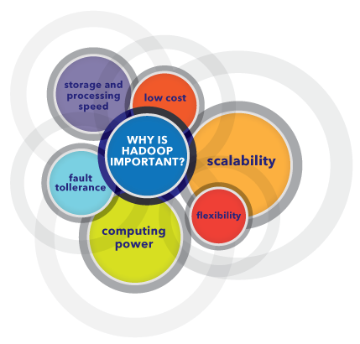

Slide 42
BENEFITS
Some of the reasons organizations use Hadoop is its’ ability to store, manage and analyze vast amounts of structured and unstructured data quickly, reliably, flexibly and at low-cost.

Slide 43
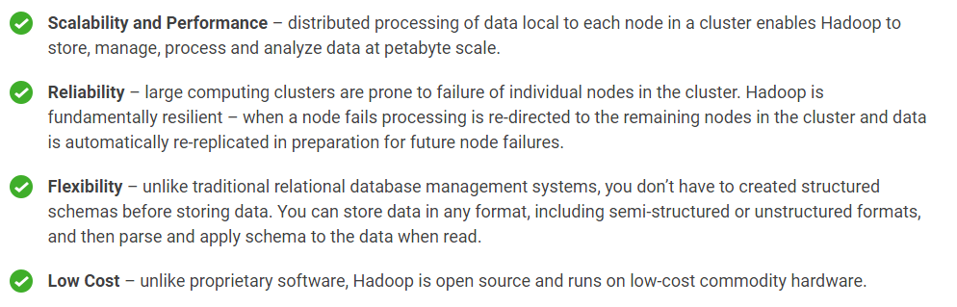

Slide 44
Modules of Hadoop
HDFS: Hadoop Distributed File System. Google published its paper GFS and on the basis of that HDFS was developed. It states that the files will be broken into blocks and stored in nodes over the distributed architecture.
Yarn: Yet another Resource Negotiator is used for job scheduling and manage the cluster.
Map Reduce: This is a framework which helps Java programs to do the parallel computation on data using key value pair. The Map task takes input data and converts it into a data set which can be computed in Key value pair. The output of Map task is consumed by reduce task and then the out of reducer gives the desired result.
Hadoop Common: These Java libraries are used to start Hadoop and are used by other Hadoop modules.

Slide 45
MapReduce
Hadoop MapReduce is a software framework for easily writing applications which process big amounts of data in-parallel on large clusters (thousands of nodes) of commodity hardware in a reliable, fault-tolerant manner.
The term MapReduce actually refers to the following two different tasks that Hadoop programs perform:
The Map Task: This is the first task, which takes input data and converts it into a set of data, where individual elements are broken down into tuples (key/value pairs).
The Reduce Task: This task takes the output from a map task as input and combines those data tuples into a smaller set of tuples. The reduce task is always performed after the map task.

Slide 46
Hadoop Distributed File System
Hadoop can work directly with any mountable distributed file system such as Local FS, HFTP FS, S3 FS, and others, but the most common file system used by Hadoop is the Hadoop Distributed File System (HDFS).
The Hadoop Distributed File System (HDFS) is based on the Google File System (GFS) and provides a distributed file system that is designed to run on large clusters (thousands of computers) of small computer machines in a reliable, fault-tolerant manner.
HDFS uses a master/slave architecture where master consists of a single NameNode that manages the file system metadata and one or more slave DataNodes that store the actual data.

Slide 47
Old vs. New Approaches
The old way is a data and analytics technology stack with different layers “cross-communicating data” and working on “scale-up” expensive hardware.
The new way is a data and analytics platform that does all the data processing and analytics in one “layer,” without moving data back and forth on cheap but scalable (“scale out”) commodity hardware.

Slide 48
The old model was top-down, slow, inflexible and expensive.
The new software development model is bottom-up, fast, flexible, and considerably less costly.

Slide 49
Open-Source Technology for Big Data Analytics
Open-source software is computer software that is available in source code form under an open-source license that permits users to study, change, and improve and at times also to distribute the software.
The open-source name came out of a 1998 meeting in Palo Alto in reaction to Netscape’s announcement of a source code release for Navigator (as Mozilla).

Slide 50
the source code is released, there are still governing bodies and agreements in place.
The most prominent and popular example is the GNU General Public License (GPL), which “allows free distribution under the condition that further developments and applications are put under the same license.”
This ensures that the products keep improving over time for the greater population of users.

Slide 51
Hadoop
MapReduce
GridGain
high performance computing cluster(HPCC)
Storm
Cassandra
Hbase
MongoDB

Slide 52
The Cloud and Big Data
cloud computing has not been a successful business model that has been widely adopted for enterprises to store their Big Data assets.

Slide 53
1. Stop saying “cloud.” It’s not about the fact that it is virtual, but the true value lies in delivering software, data, and/or analytics in an “as a service” model. Whether that is in a private hosted model or a publicly shared one does not matter. The delivery, pricing, and consumption model matters.
2. Acknowledge the business issues. There is no point to make light of matters around information privacy, security, access, and delivery. These issues are real, more often than not heavily regulated by multiple government agencies, and unless dealt with in a solution, will kill any platform sell.
3. Fix some core technical gaps. Everything from the ability to run analytics at scale in a virtual environment to ensuring information processing and analytics authenticity are issues that need solutions and have to be fixed.

Slide 54
Crowdsourcing Analytics
Crowdsourcing is the process of getting work or funding, usually online, from a crowd of people.
The word is a combination of the words 'crowd' and 'outsourcing'. The idea is to take work and outsource it to a crowd of workers.
Famous Example: Wikipedia. Instead of Wikipedia creating an encyclopedia on their own, hiring writers and editors, they gave a crowd the ability to create the information on their own. The result? The most comprehensive encyclopedia this world has ever seen.

Slide 55
Different Types of Crowdsourcing
Crowdsource Design
Crowdfunding
Crowdsource Design:
If you’re looking for a logo design, you can tell a crowd of designers what you want, how much you will pay, and your deadline.
All interested designers will create a finished design specifically for you. You’ll receive 50-300+ different finished logo designs, and you can keep whichever design you like the best.
By doing design this way, crowdsourcing actually increases the quality & decreases the price, compared to online freelancing.
Crowdsourcing can also be used to get designs for furniture, fashion, advertisements, video, & product design. Just about anything that can be designed can be crowdsourced.

Slide 56
Crowdfunding involves asking a crowd of people to donate money to your project.
Crowdfunding is mostly used by artists, charities, & start-ups to raise money for projects such as filming a documentary, manufacturing an iPod watch, cancer research, or seed money

Slide 57
Industry Examples of Big Data

Slide 58
Big Data for the Enterprise
With Big Data databases, enterprises can save money, grow revenue, and achieve many other business objectives, in any vertical.
Build new applications: Big data might allow a company to collect billions of real-time data points on its products, resources, or customers – and then repackage that data instantaneously to optimize customer experience or resource utilization.

Slide 59
Improve the effectiveness and lower the cost of existing applications: Big data technologies can replace highly-customized, expensive legacy systems with a standard solution that runs on commodity hardware.
Many big data technologies are open source, they can be implemented far more cheaply than proprietary technologies.

Slide 60
Realize new sources of competitive advantage: Big data can help businesses act more nimbly, allowing them to adapt to changes faster than their competitors.
Increase customer loyalty: Increasing the amount of data shared within the organization – and the speed with which it is updated – allows businesses and other organizations to more rapidly and accurately respond to customer demand.

